Slide 1
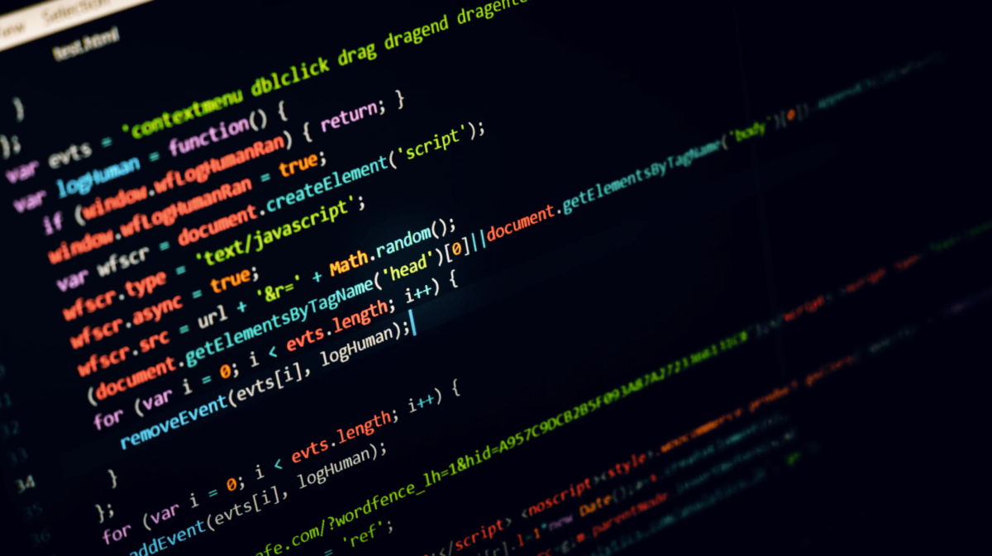
Getting started with Python
Antariksh Pratham

Slide 2
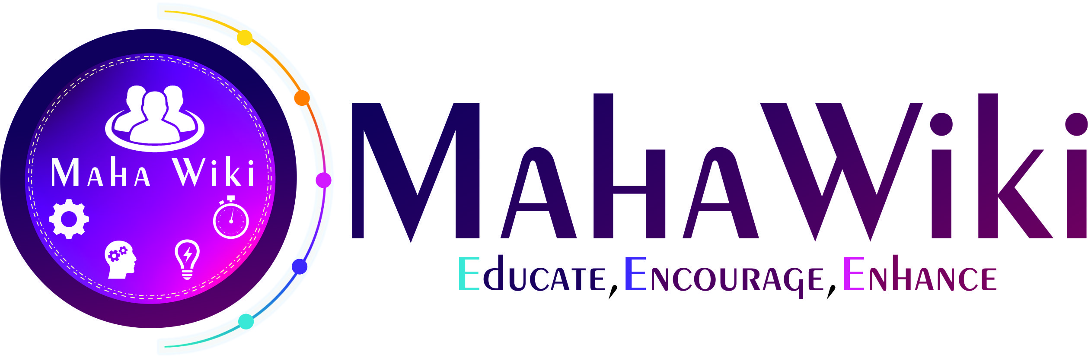
Thank you Mahawiki for this wonderful opportunity

Slide 3
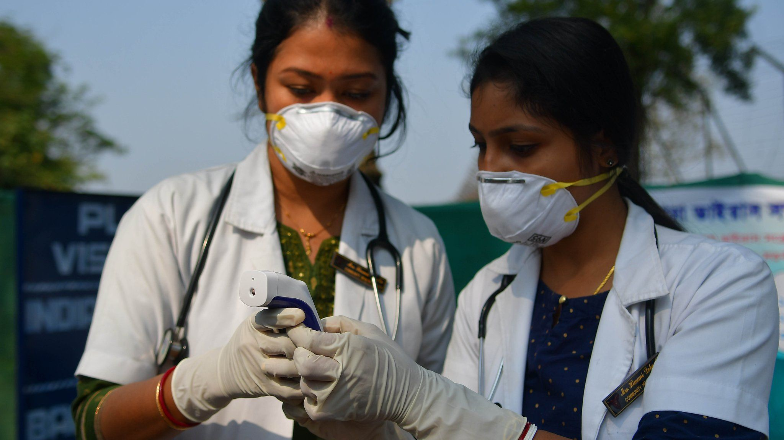
Towards building a responsible society

Slide 4
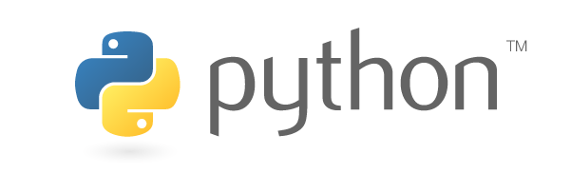
The story of a language
Originally built in the late 1980s as a successor to ABC for Amoeba operating system
Implementation began in December 1989; first released in 1991
Named Python after 1970s BBC comedy Monty Python’s Flying Circus
Van Rossum announced his retirement from his responsibilities as BDFL in July 2018

Slide 5
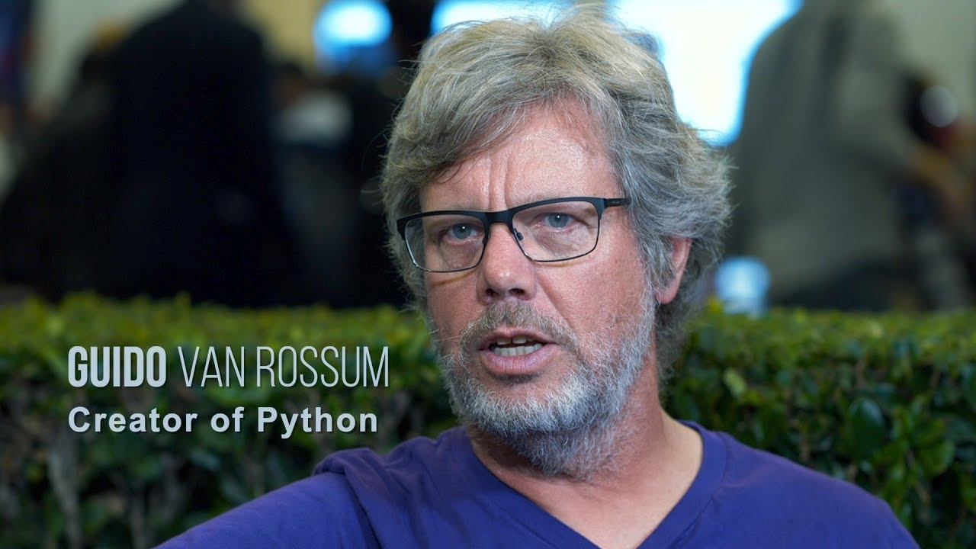

Slide 6

Why Python?
Object Oriented and Interpreted
Open Source
Large number of libraries
Dynamically typed
Portable
Notes:
Garbage collection, functional

Slide 7
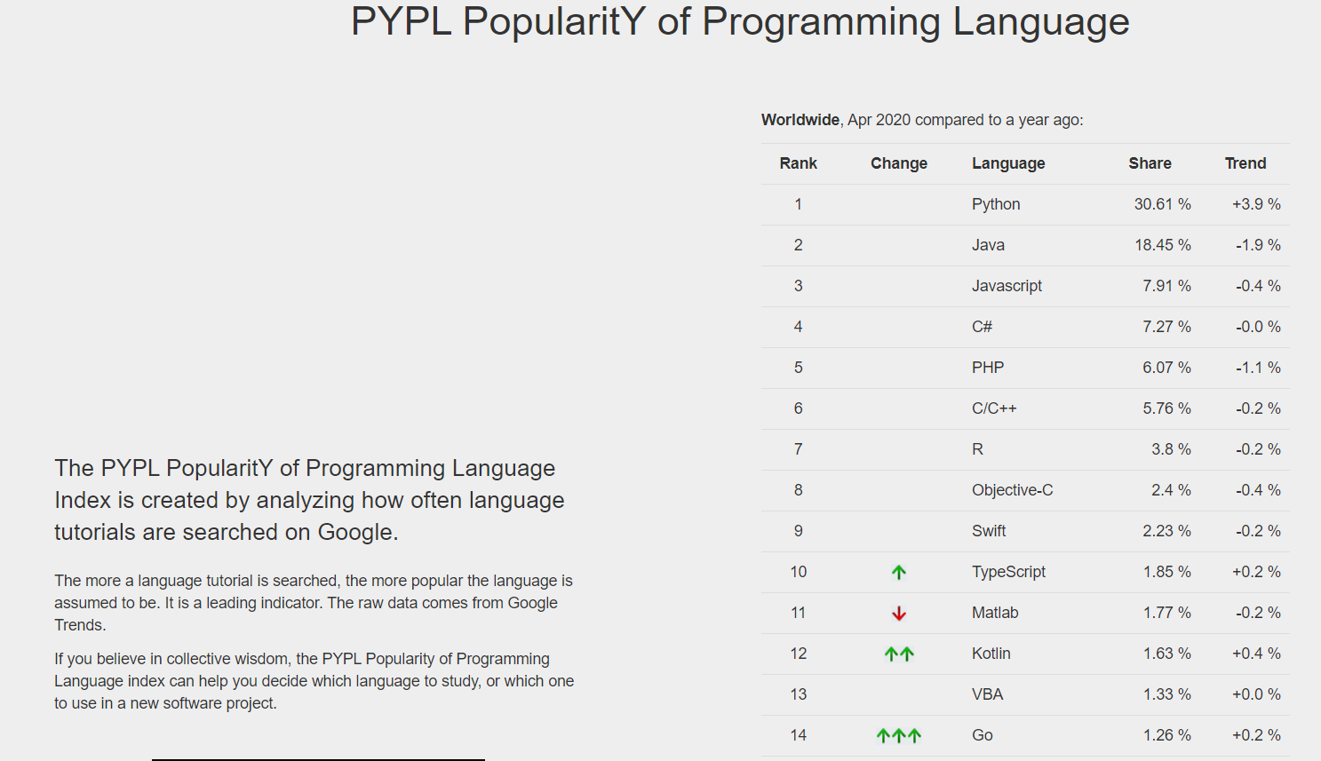

Slide 8
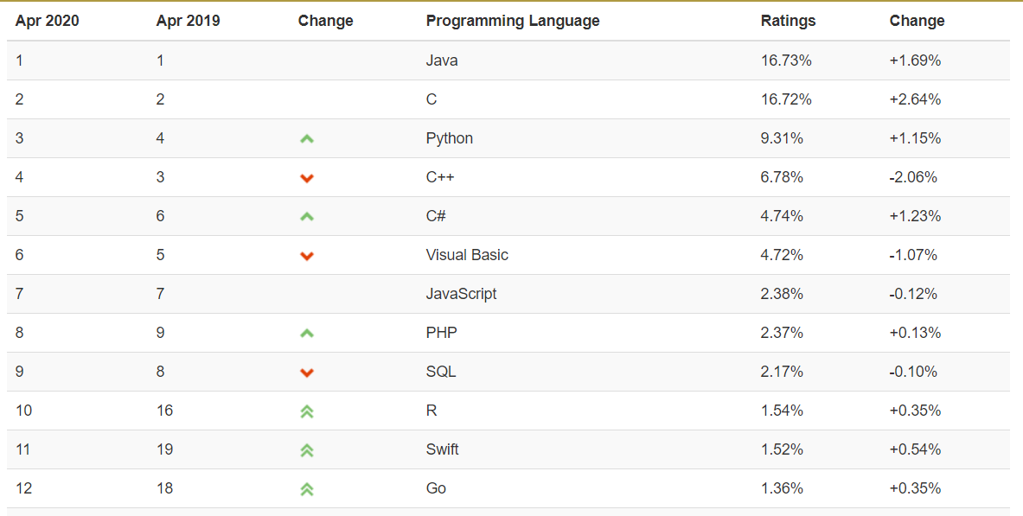
TIOBE
Notes:
The Importance Of Being Earnest

Slide 9
Is Python really difficult?
“Code that is as understandable as
plain english”
– Guido van Rossum on Python

Slide 10
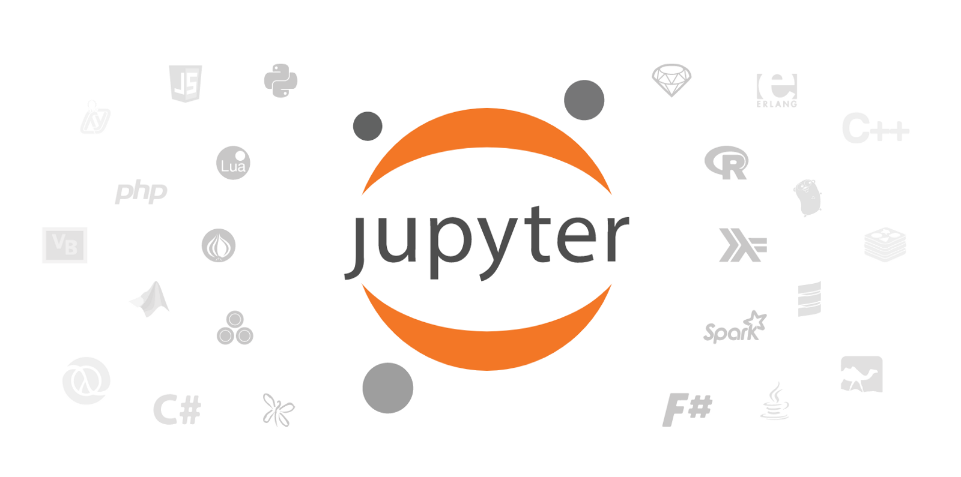
Python development environments
PyCharm
Atom IDE
Jupyter Notebook
and many more…

Slide 11
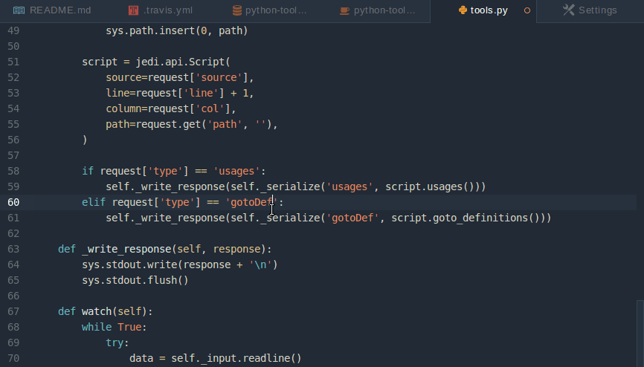

Slide 12


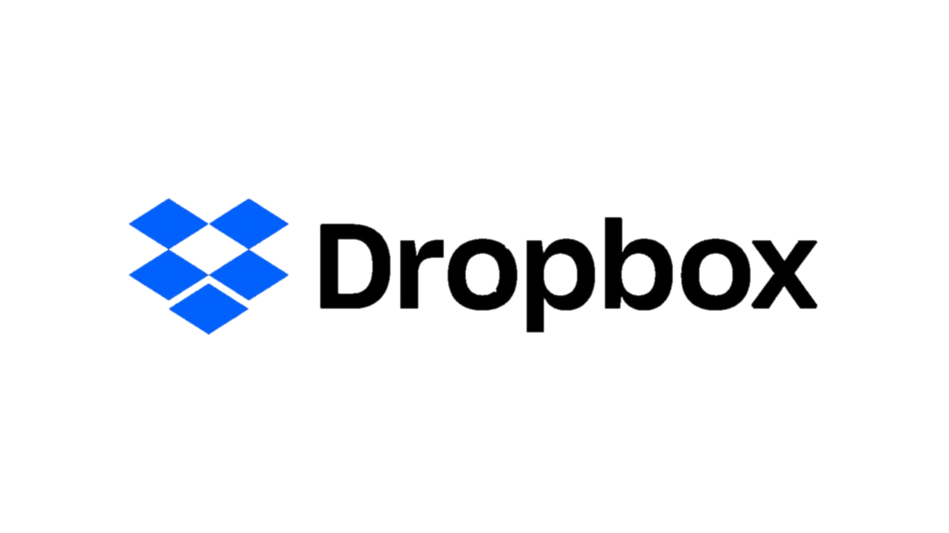
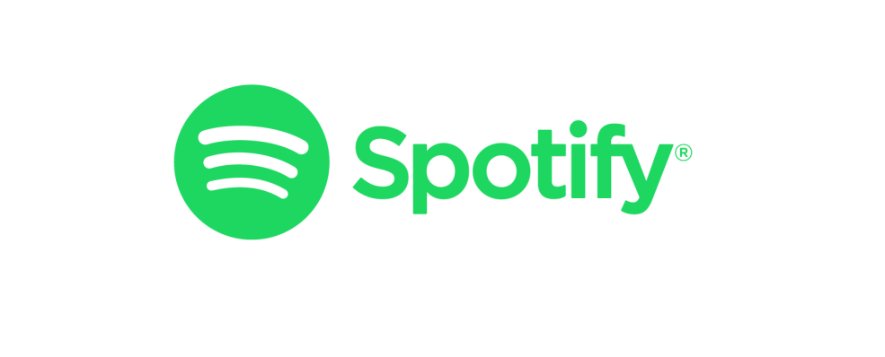
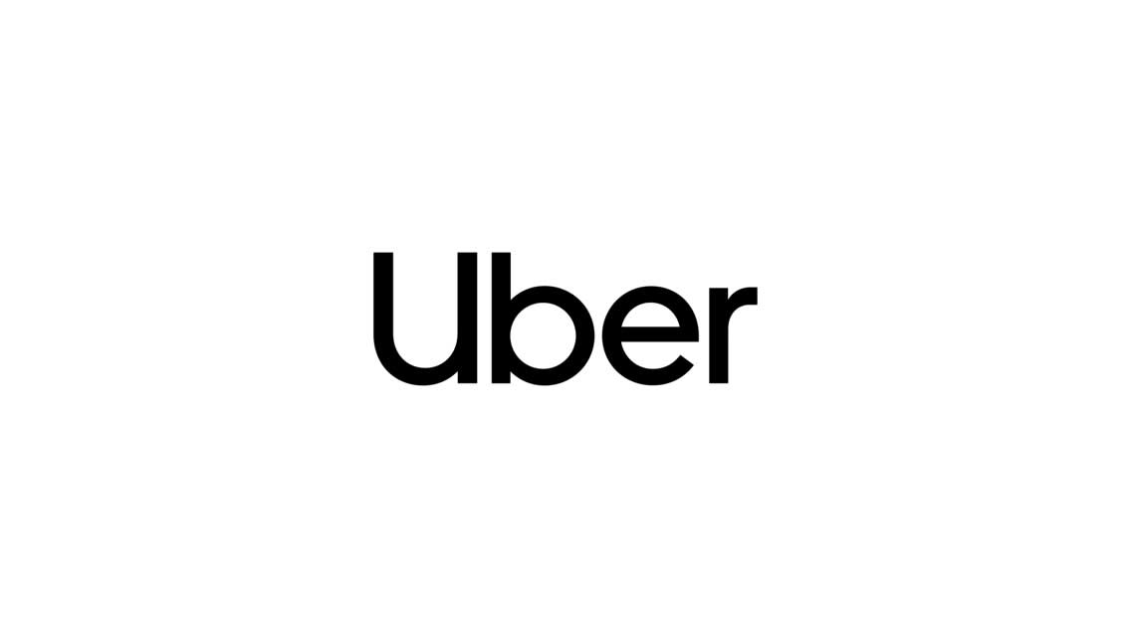
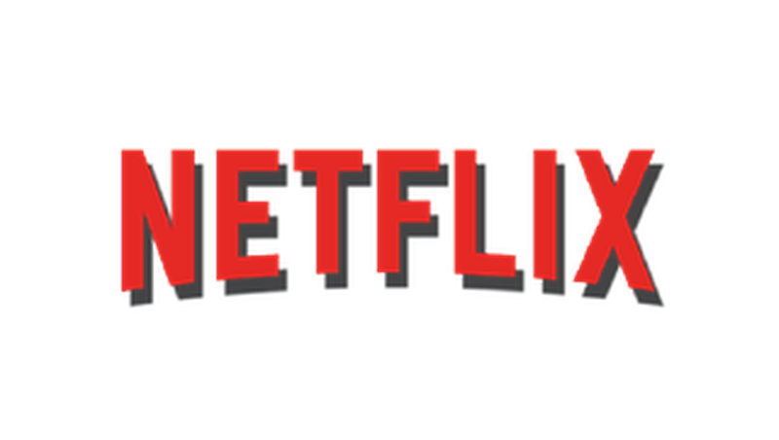

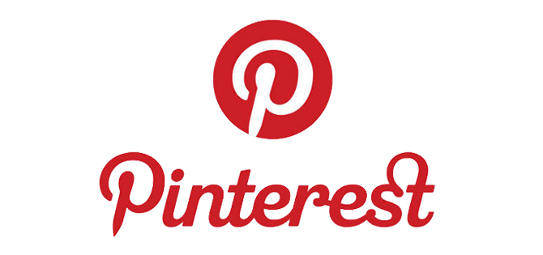
Applications of Python

Slide 13
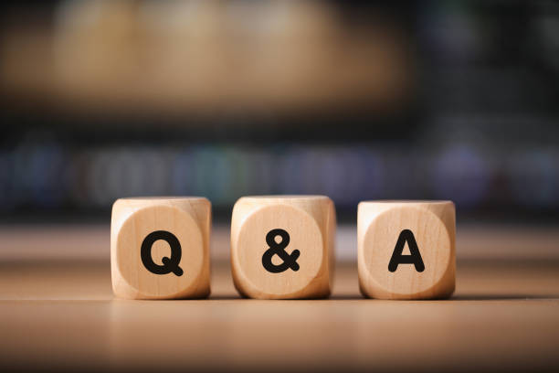

Slide 14

https://bit.ly/mahawiki

Slide 15

Thank You

